Slide 1
STATE OF TEXAS v GRESHAM SESTOSO

Slide 2
RUSH TO JUDGMENT

Slide 3
3 RULES
1. PRESUMPTION OF INNOCENCE
2. BURDEN IS ON THE STATE
3. BEYOND A REASONABLE DOUBT

Slide 4
TELL YOUR NEIGHBOR/SPOUSE/FRIENDS
September 27, 2015
6:00 a.m.
Gresham Sestoso (35)
Headed Home

Slide 5
RIPKOWSKI
Asleep Behind the Wheel
Polite, Coherent, Cooperative
Odor of Alcohol
Red Glassy Eyes
Not Slurred – Slight Asian Accent
Not Enough for Probable Cause for DWI

Slide 6
RIPKOWSKI
HGN at the Scene
Not Sure if Intoxicated or Not
HGN in the Parking Lot
Concussion, Contacts, Purely Subjective
Doesn’t Measure Mental or Physical
Walk and Turn
One Leg Stand
“Can’t Drink and Then Drive”

Slide 7
WILLIAMS
HGN / Walk and Turn / One Leg Stand
Swore to Tell the Truth
Refusal is NOT Illegal
Blood – Inversions and Transport??

Slide 8
OWNEN
Sanitary
Left AC
Betadine
Back and Forth Wipe
Straight Draw / Butterfly Needle
2 Inversions
Sealed the Tubes
Good Job!!

Slide 9
RODGERS
At the TIME OF DRIVING
Retrograde Extrapolation
Factors that Can Affect
Has ALWAYS Testified:
Result Is Accurate
Machine Is Working Properly
Proper Protocol Was Filed
Client Was Intoxicated

Slide 11
AT THE TIME OF DRIVING
Over a 0.08 AT THE TIME OF DRIVING
.10-.19
.04

Slide 12
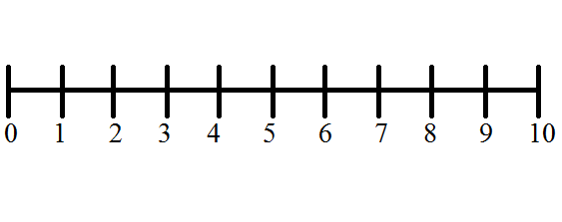
PRESUMPTION OF INNOCENCE
INNOCENT GUILTY

Slide 13
ASSUME
v.
PRESUME

Slide 14
REASONABLE DOUBT?
Highest Burden in the Land
Beyond A Reasonable Doubt

Slide 15
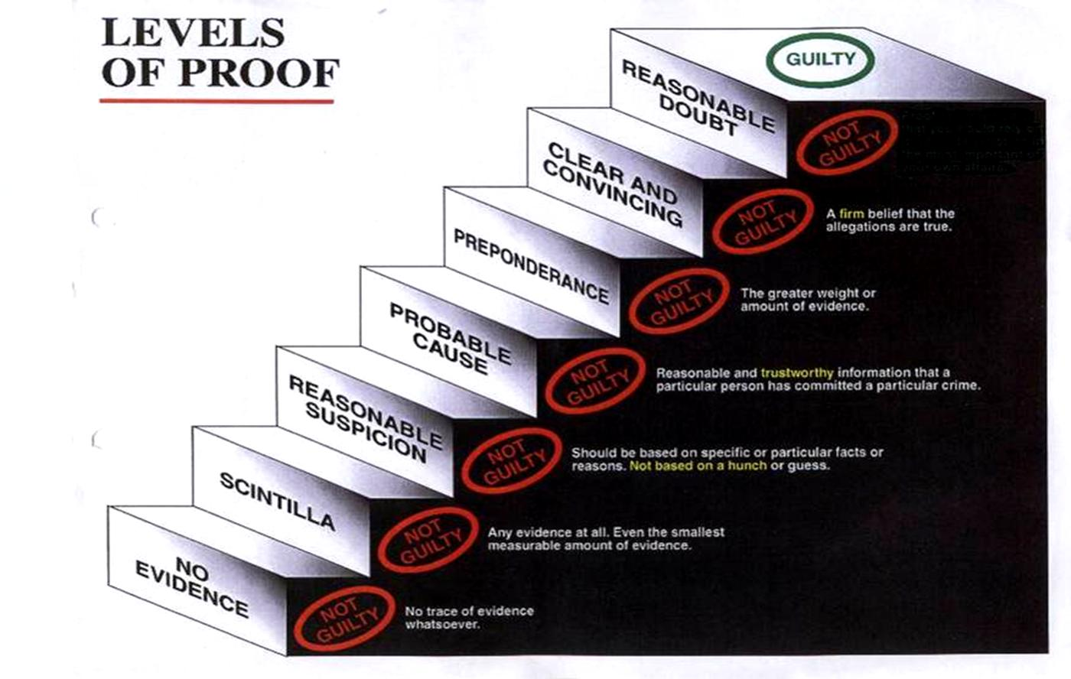

Slide 16
COMMON SENSE
What Does Someone Look Like .19?

Slide 17
LOSS OF MENTAL DUE TO INTOX???
LOSS OF PHYSICAL DUE TO INTOX???
>0.08 AT THE TIME OF DRIVING???

Slide 18
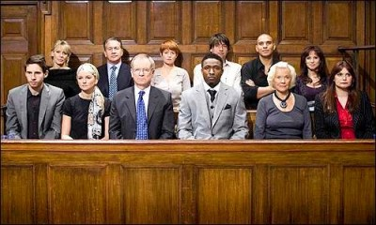
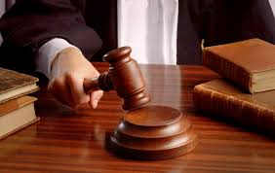
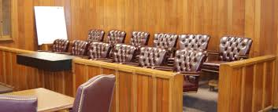
JURY SERVICE

Slide 19
BE PROUD OF YOUR VERDICT

Slide 20
NOT GUILTY

Slide 21
THANK YOU

